Slide 1
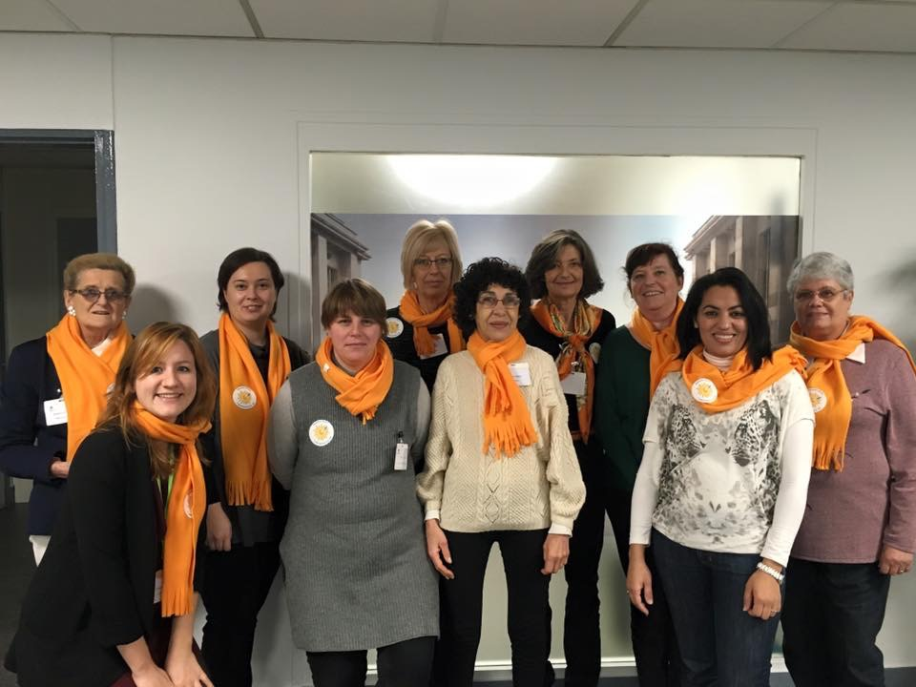
26 11 2015
TELETHON
A L’ AMR

